Slide 1



Tools:
Aspirant Data Analyst

Slide 2

Introduction
About Company:
AtliQ Hardware is a company that sells computer hardware to customers worldwide.
Overview:
A comprehensive analysis of consumer goods performance was conducted to know:
Market Reach & Expansion
Products Insights
Customer & Channel Dynamics
Performance Metrics
Objective:
Ad-Hoc requests
This is part of the Resume Project Challenge by Codebasics

Slide 3
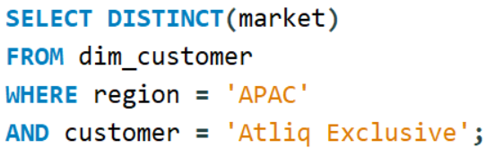
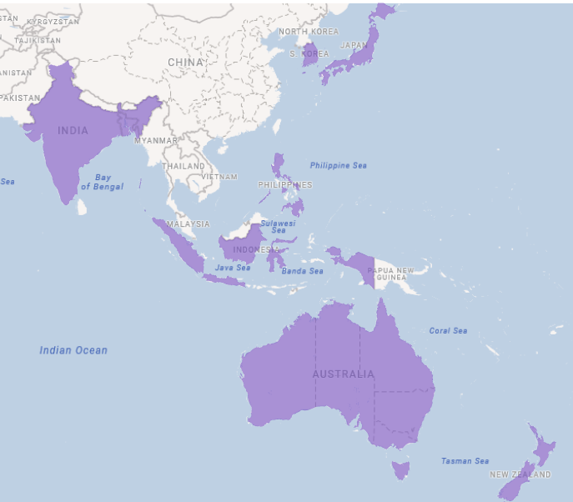
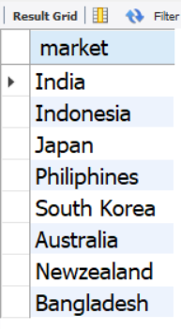
Request 1- Provide the list of markets in which customer “AtliQ Exclusive” operates its business in the APAC region.
QUERY-
Visual-
OUTPUT-
INSIGHTS-
AtliQ Hardware serves customers in 27 countries across various regions.
Once of the customers, Atliq Exclusive operates in 16 countries with 8 of them located in the Asia-Pacific (APAC)region.
This is part of the Resume Project Challenge by Codebasics

Slide 4

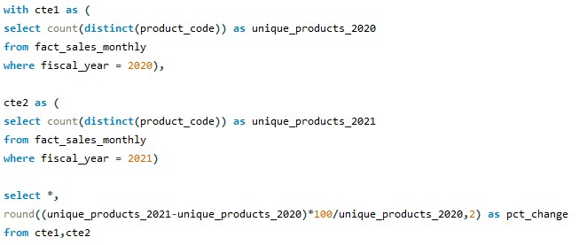
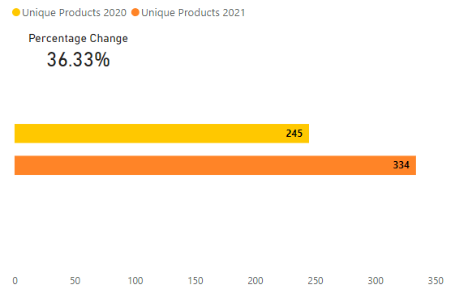
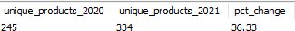
Request-2 What is the percentage of unique product increase in 2021 vs 2020?
QUERY-
Visual-
OUTPUT-
INSIGHTS-
In 2021 36.33% new products were sold as compared to the previous year.
This is part of the Resume Project Challenge by Codebasics

Slide 5
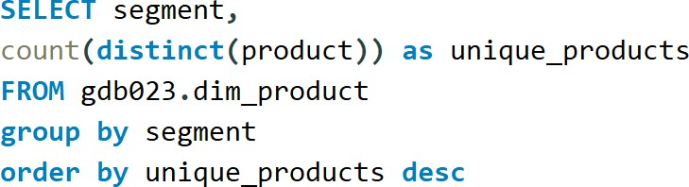
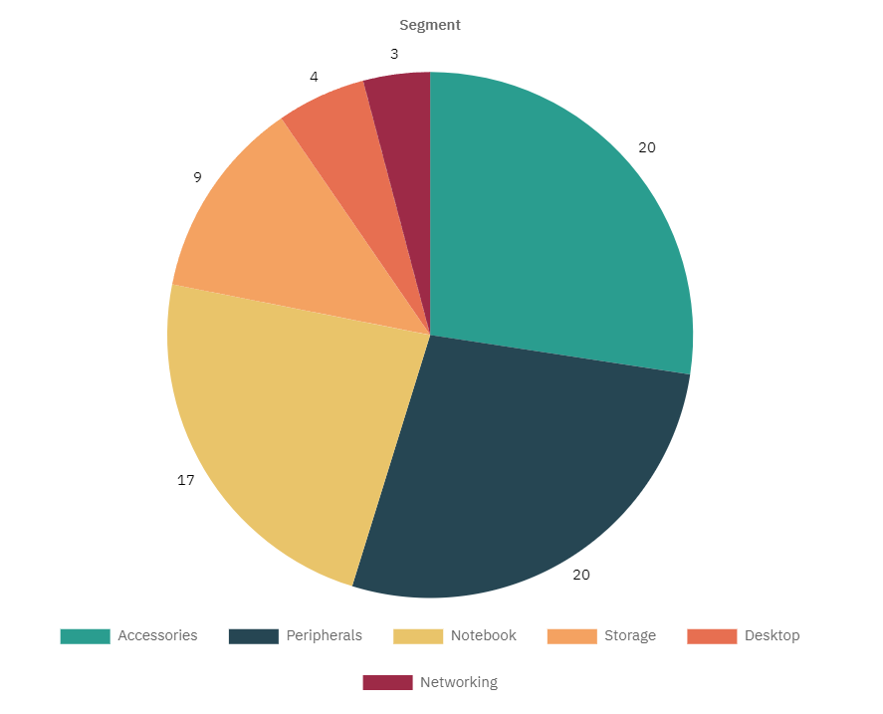
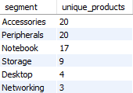
Request-3 Provide a report with all the unique product counts for each segment and sort them in descending order of product counts.
QUERY-
Visual-
OUTPUT-
INSIGHTS-
The accessories & peripherals segments comprise 54% of the total unique products.
This is part of the Resume Project Challenge by Codebasics

Slide 6
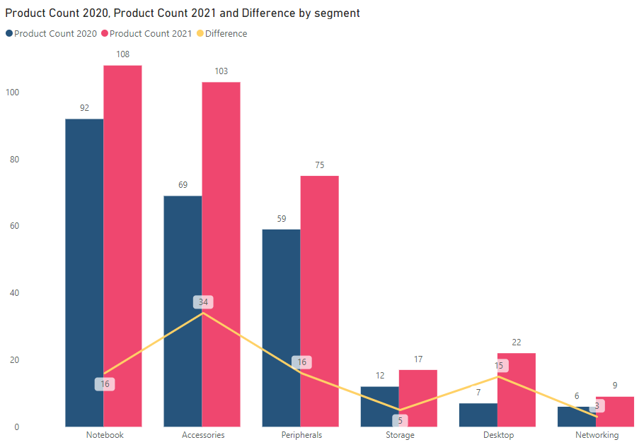
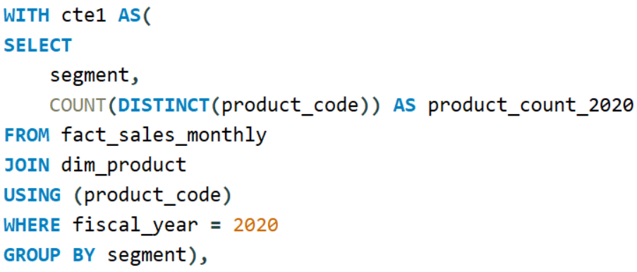
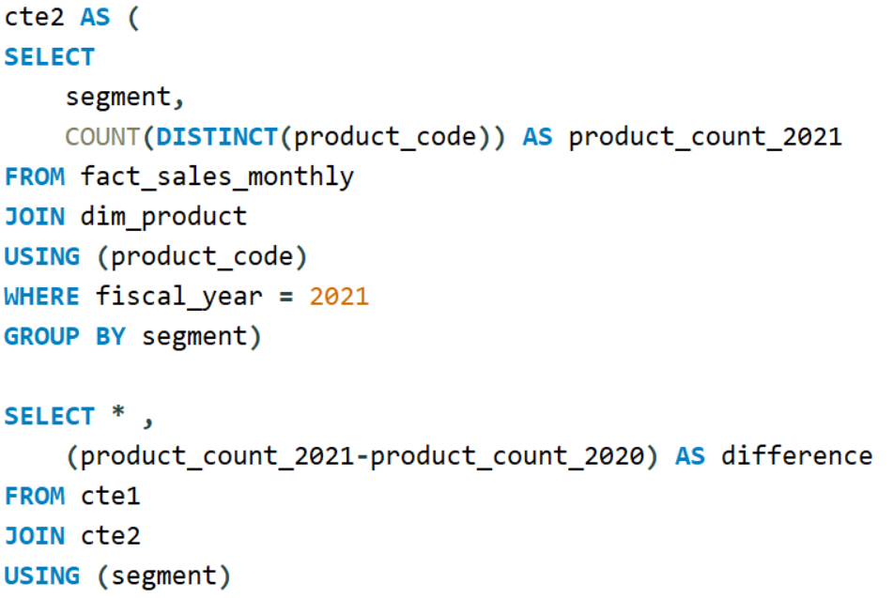
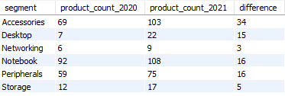
Request-4 Which segment had the most increase in unique products in 2021 vs 2020?
Visual-
QUERY-
OUTPUT-
INSIGHTS-
The accessories segments experienced the largest growth in unique products adding 34 new products in 2021.
This is part of the Resume Project Challenge by Codebasics

Slide 7
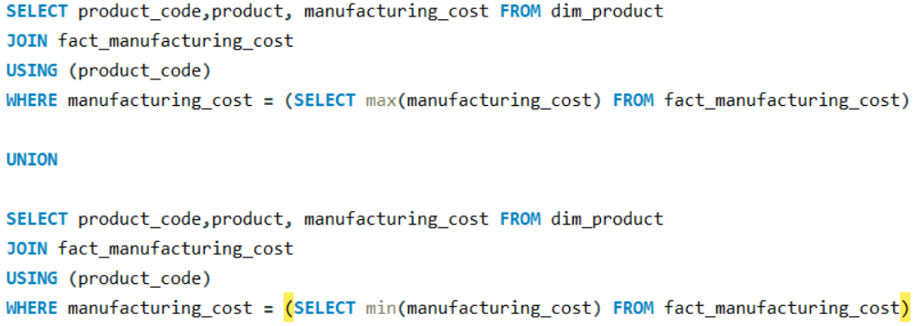
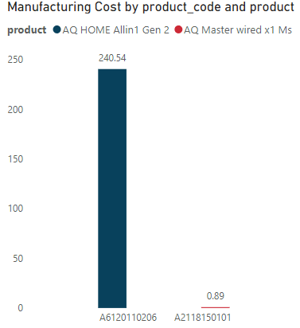
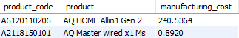
Request-5 Get the products that have the highest and lowest manufacturing costs.
QUERY-
Visual-
OUTPUT-
INSIGHTS-
Among all the products ‘Home Allin 1 Gen 2’ has highest whereas ‘Master wired x 1 Ms’ has the lowest manufacturing cost.
The manufacturing cost of ‘Home Allin 1 Gen 2’ is 270 times higher than that of ‘Master wired x1Ms’.
This is part of the Resume Project Challenge by Codebasics

Slide 8
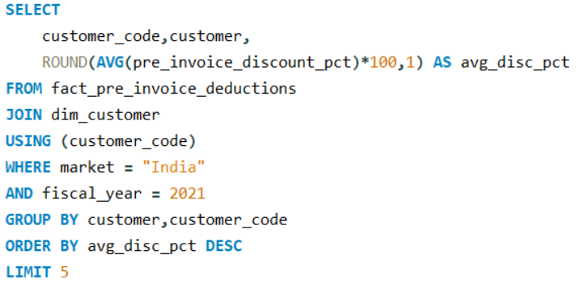
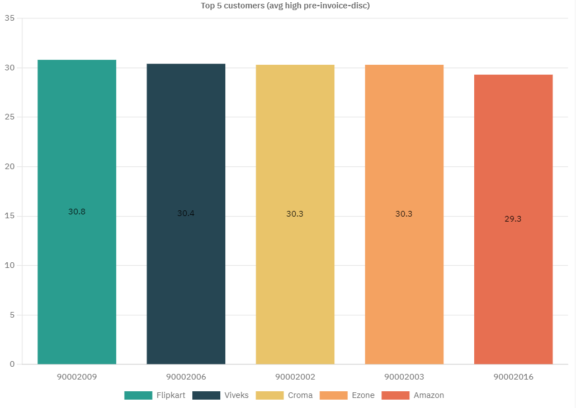
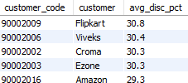
Request-6 Generate a report which contains the top 5 customers who received an average high pre-invoice discount pct for the fiscal year 2021 and in the Indian market.
QUERY-
Visual-
OUTPUT-
INSIGHTS-
In 2021 in the Indian market Filpkart received the highest average pre-invoice discount followed by Viveks, Croma, Ezone and Amazon.
This is part of the Resume Project Challenge by Codebasics

Slide 9
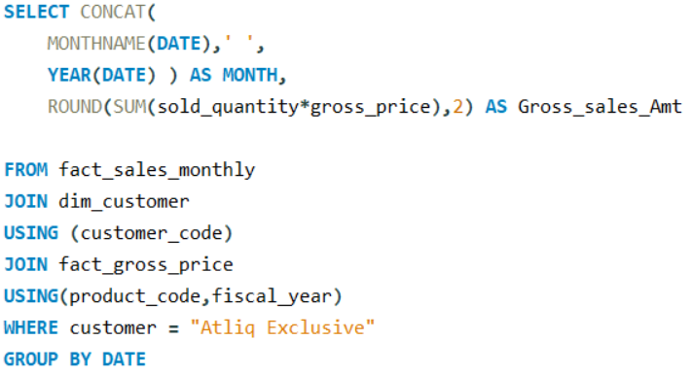
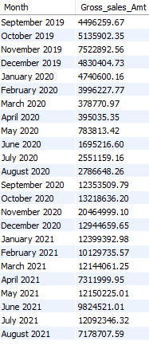
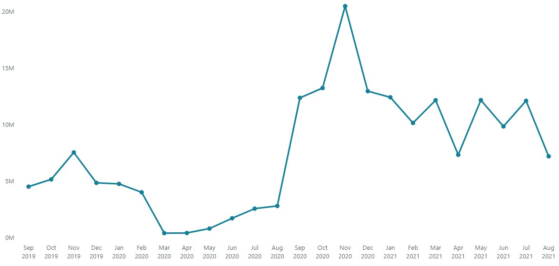
Request-7 Get the complete report of the Gross sales amount for the customer “Atliq Exclusive” for each month.
QUERY-
INSIGHTS-
For Atliq Exclusive November 2020 recorded the highest Gross sales amount reaching 20 Millions.
OUTPUT-
Visual-
This is part of the Resume Project Challenge by Codebasics

Slide 10
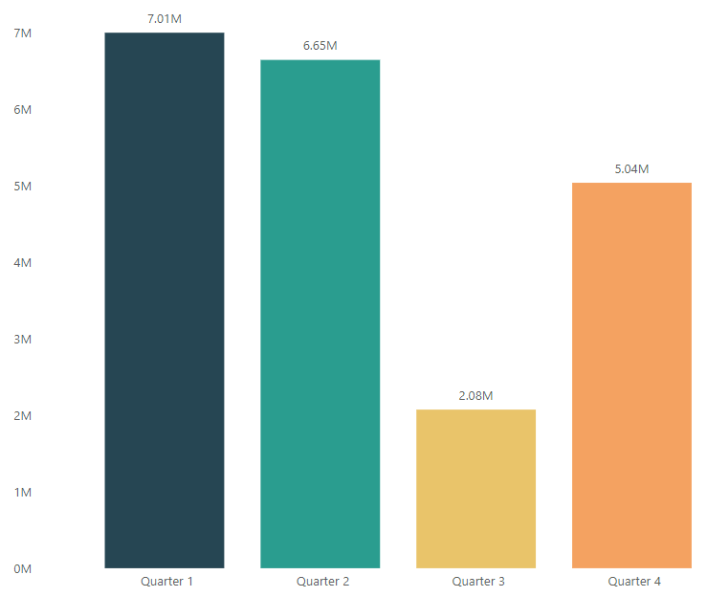
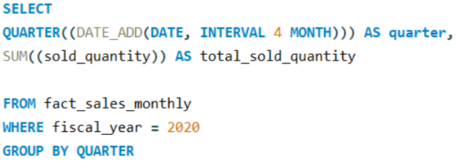
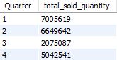
Request-8 In which quarter of 2020 got the maximum total sold quantity?
Visual-
QUERY-
OUTPUT-
INSIGHTS-
In FY 2020 Q1 achieved the highest sold quantity exceeding 7 million units.
Sold quantities declined in Q2 and Q3 rebounded in Q4 reaching 5.04 million units.
This is part of the Resume Project Challenge by Codebasics

Slide 11
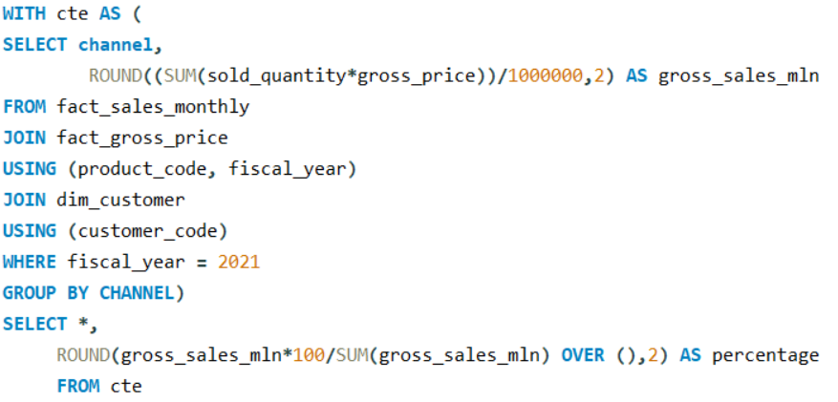
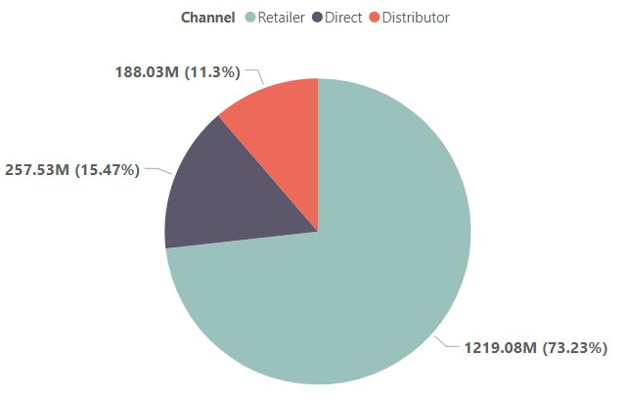
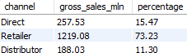
Request-9 Which channel helped to bring more gross sales in the fiscal year 2021 and the percentage of contribution?
QUERY-
Visual-
OUTPUT-
INSIGHTS-
The Retailer channel contributed 73.23% of the Gross sales.
This is part of the Resume Project Challenge by Codebasics

Slide 12
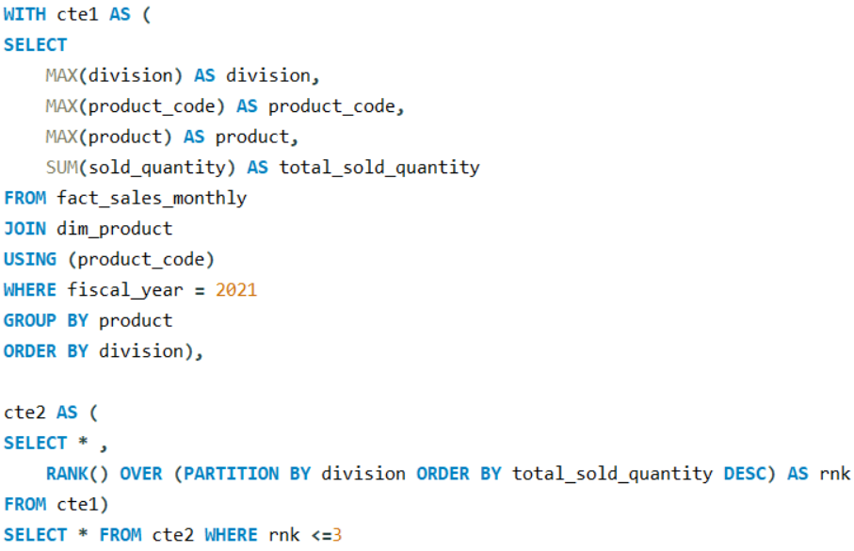
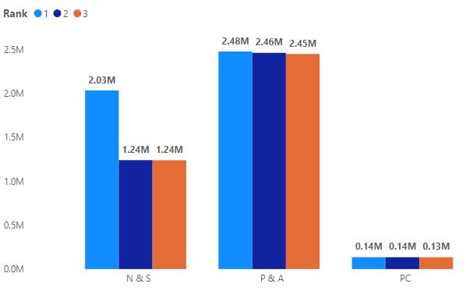
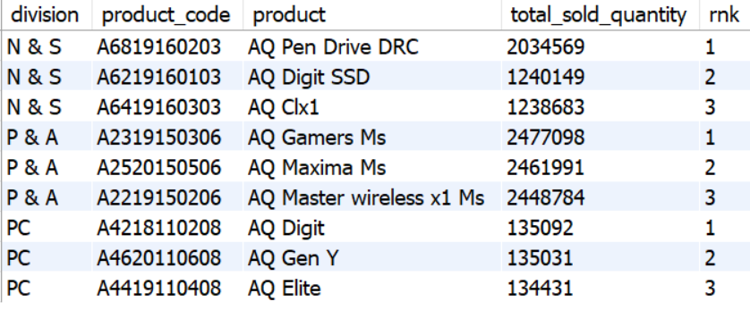
Request-10 Get the Top 3 products in each division that have a high total sold quantity in the fiscal year 2021?
QUERY-
Visual-
OUTPUT-
INSIGHTS-
The Top 3 products from P&A division each surpassed 2.4M units in sold quantity.
This is part of the Resume Project Challenge by Codebasics
Notes:
"Knowing your bestsellers is key! The top 3 products in the P&A division each surpassed 2.4 million units in sold quantity. This insight is crucial for inventory planning and promotional strategies."

Slide 13
Image Source: www.google.com Resume Project Challenge #4: www.codebasics.io GitHub: click to view Thank you
This is part of the Resume Project Challenge by Codebasics

